Slide 1

How to Create/Share Indicators and SOC Metrics Efficiently
SANSFire 2018

Slide 2
Overview
Discuss how and why we revamped our entire incident tracking
TheHive Project
Lime Survey
MISP

Slide 3

About Me
Deputy CISO & SOC manager
SANS GSE #76
Internet Storm Center Volunteer
SANS Mentor
webbtc@mailbox.sc.edu
@twsecblog

Slide 4

About USC
Enrollment ~55,000​
Fac/Staff FT&PT ~ 18,000​
8 Campus System​
Distributed IT​
Each Campus​
Each Department​
Centrally Manage ~3,000 Desktops
Network Centrally Managed

Slide 5
About UISO
Total Staff of 11
CISO
3 Governance, Risk, Compliance and Architecture
6 SOC members
2 Analysist
2 Engineers
1 Senior Engineer
Manager
1 Desktop Engineer
3 Interns

Slide 6
What’s the Problems?
Inconsistent data from pervious systems
Difficulty analysis of data
Indicators not being utilized and only a few were being tracked
Ability to easily share indicators in a meaning and easy way

Slide 7
Threat/Data Centric Strategy
Focus on Threats EDUs see from DBIR, REN-ISAC and locally seen
Overlay our controls on top of attach methodologies (e.g. Kill Chain)
Implement strategies to prevent
This requires good data to implement and track effectiveness long term

Slide 8
Hive
TheHive project is a Incident Response Platform that aids the analysis in analysis of artifacts and integrates this other systems.
Open Source
Its available in several forms, but I recommend the Docker.
Uses Elastic Search on the backend
Updated frequently
Active support community
https://thehive-project.org

Slide 9
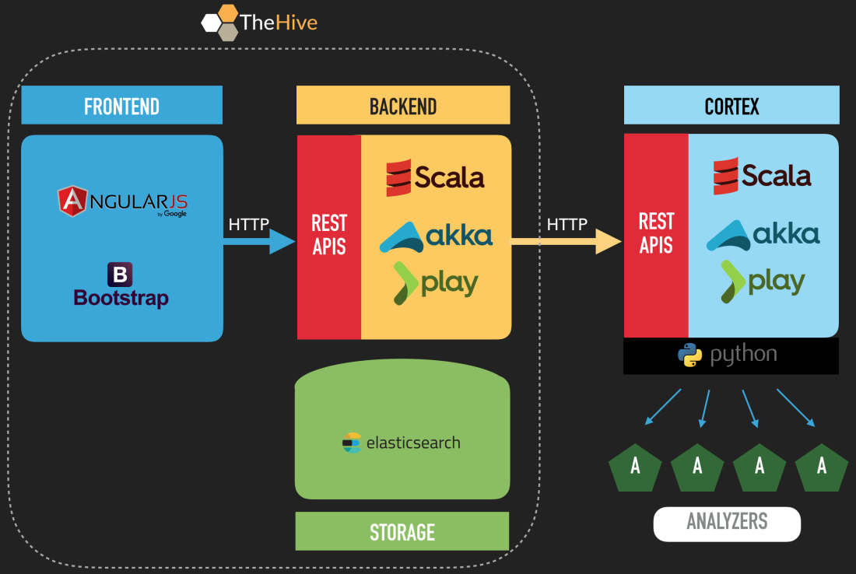
Hive Architecture
Notes:
https://blogthehiveproject.files.wordpress.com/2017/02/architecture.png?w=1100

Slide 10
Hive FEATURES

Slide 11
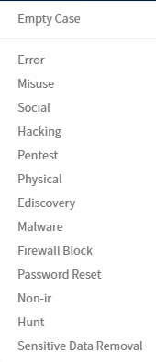
Case templates
This allows us to create specific playbooks and metrics within the ticketing system.

Slide 12

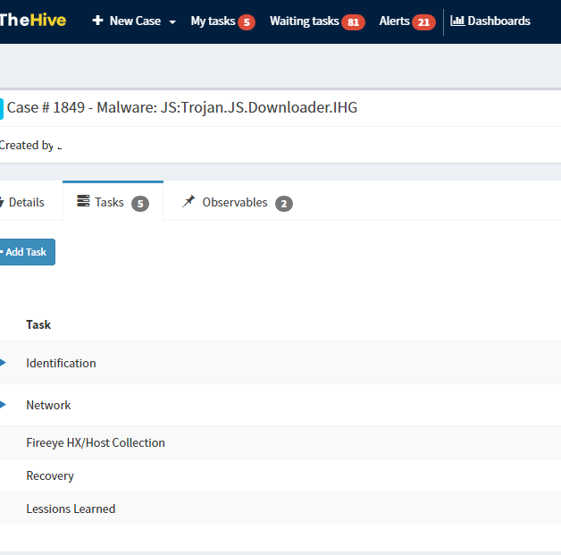
Tasks per Template
Each template can have custom tasks that go along with your playbook.
Once inside the tasks you can have detailed walk though for your responder to complete.

Slide 13
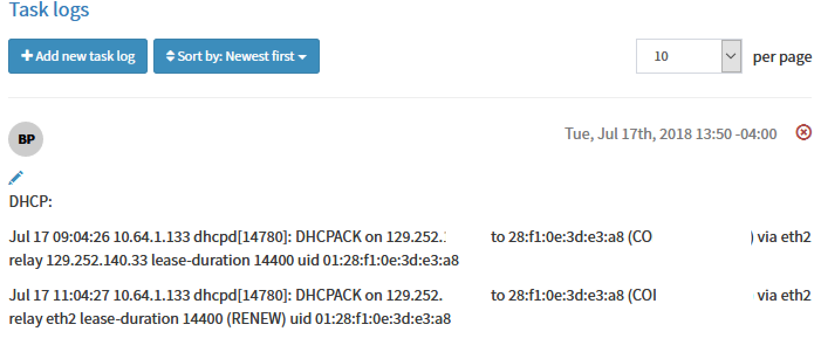

Slide 14
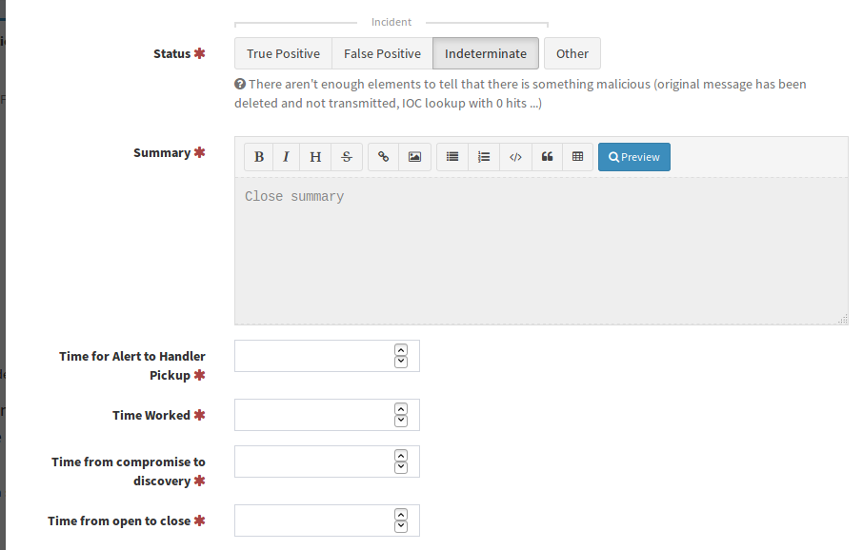
Hive Metrics
Required to close case
Freeform only
Can be assigned to individual
case templates

Slide 15
Alarms vs Triage
Last 30 days of Alarms

Slide 16
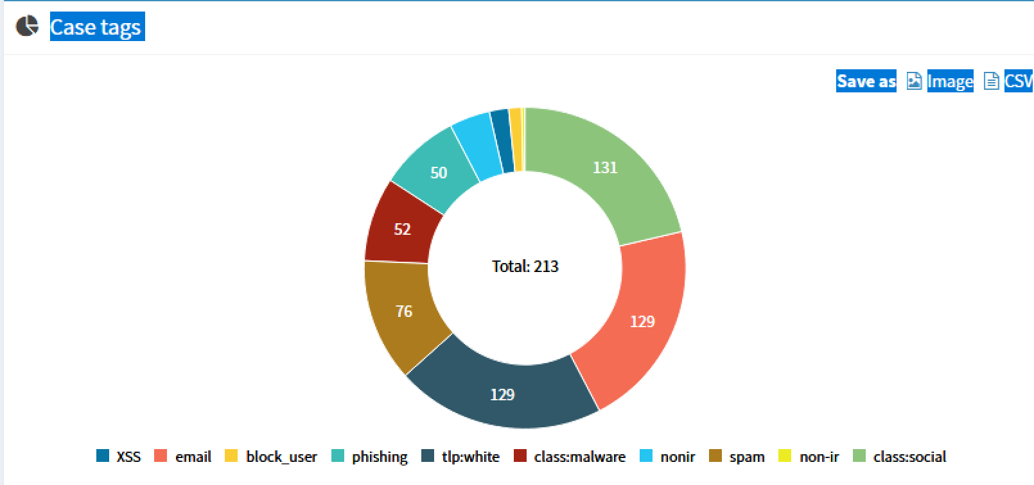
Tags for last 30 days

Slide 17
Overall Workflow

Slide 18
Lime Survey
Mirror the Verizon DBIR Questions
Ask up to 40 questions depending on answers
Track what controls that would have prevented the compromise
Items were interpreted differently by different people

Slide 19
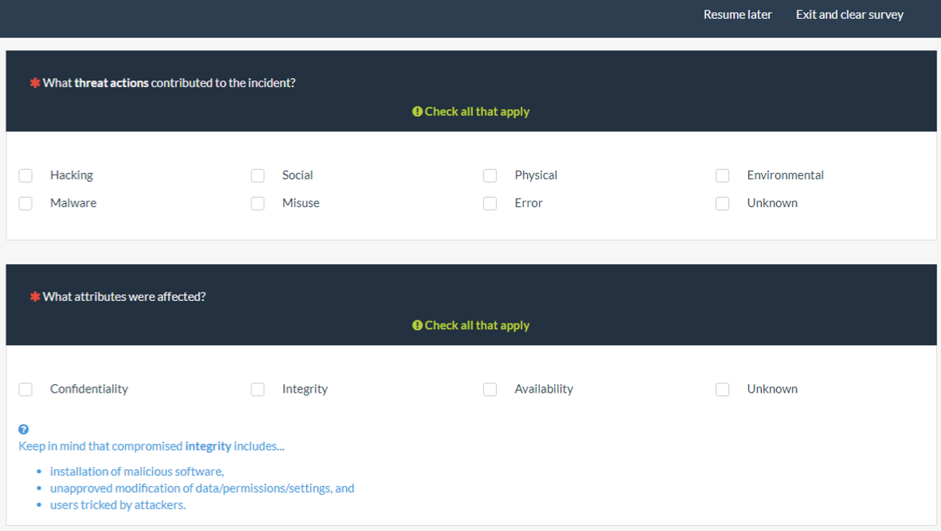

Slide 20

HOw are we using this data?

Slide 21
True Positives

Slide 22
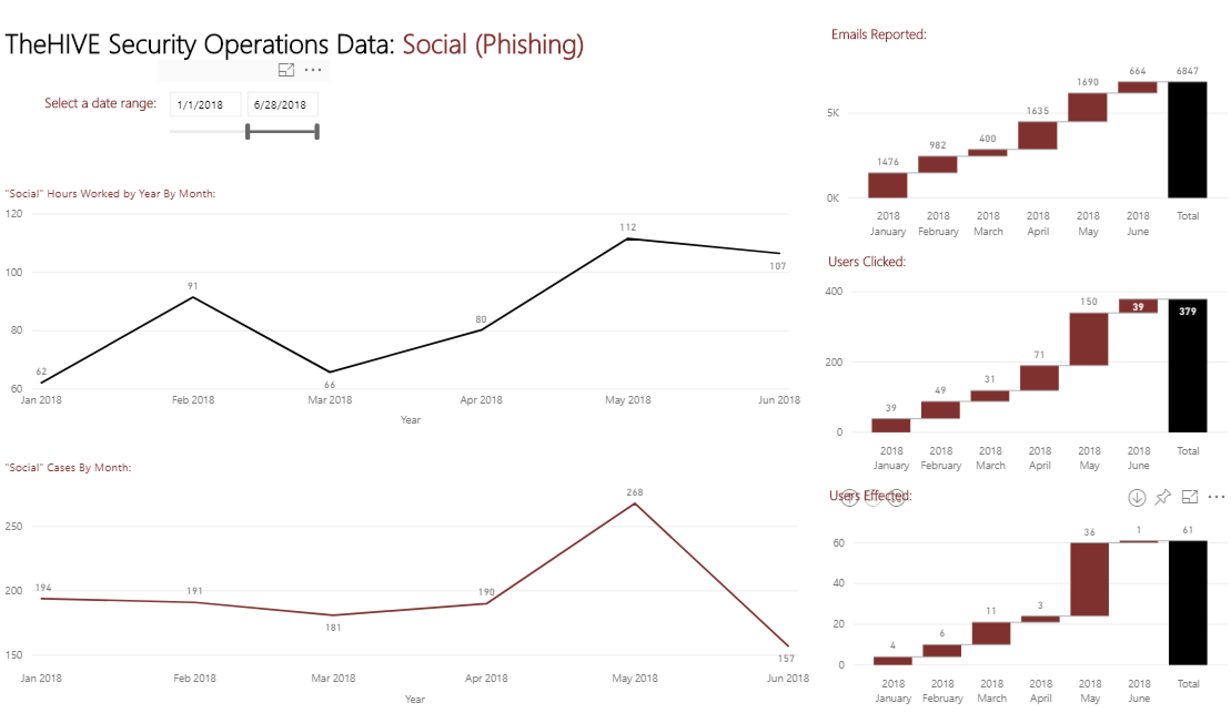
Power BI Phishing Dashboard

Slide 23
Threat Intel/IOC and Automation

Slide 24
Indicators vs Intel
Indicator
Something that attacker/malware has done that might be a sign of compromise
E.G malicious callback IP, hash, reg key
Intel
Has context around the data so you understand what the indicator mean and a human provided analysis of it.
Attacker X uses this IP to download malware, once installed the attacker move to your AD servers

Slide 25
Cortex
Cortex is a separate service that integrates with the hive to preform automated analysis on indicators uploaded to the hive.
Currently they have ~90 analyzers that can be used to do automated lookups
Virustotal
HybridAnalysis
CuckooSandox
MISP
SinkDB
Bluecoat
Robtex
Shodan

Slide 26
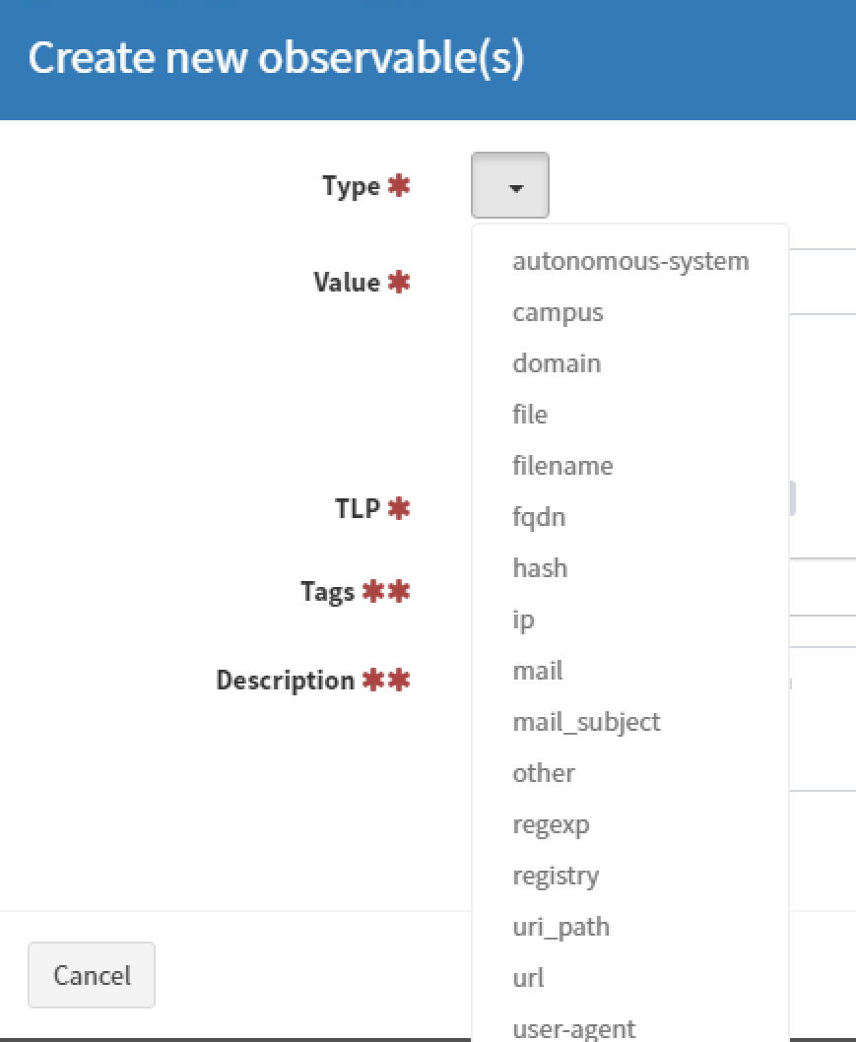
Create a new observable

Slide 27
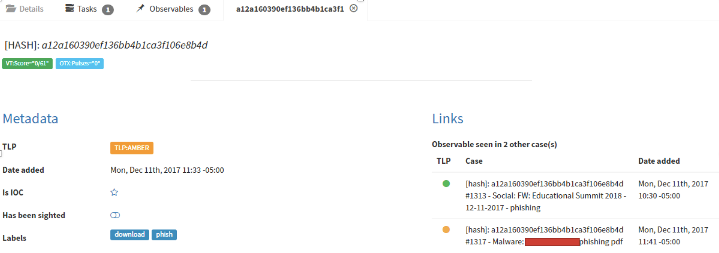
Other Cases Linked to malware

Slide 28
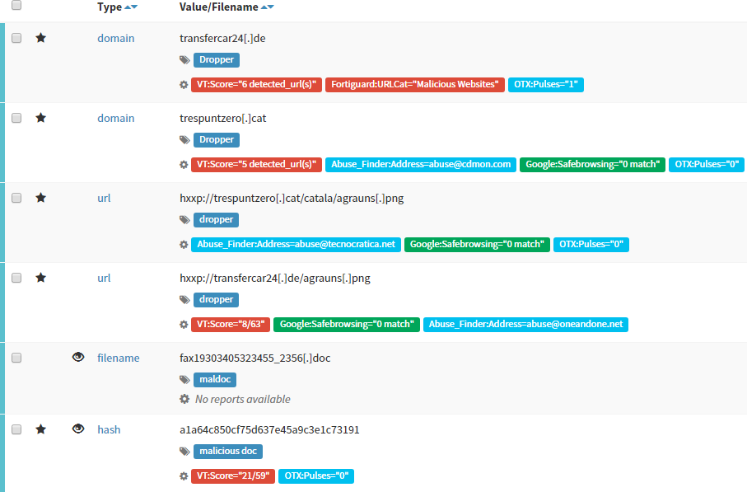

Slide 29
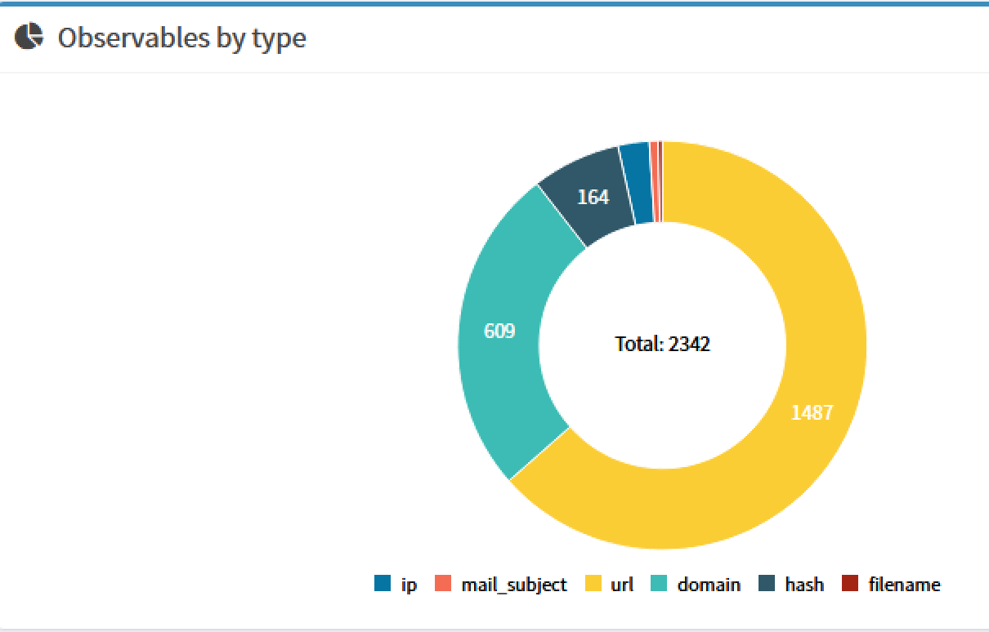
Observables
Last 3 Months

Slide 30
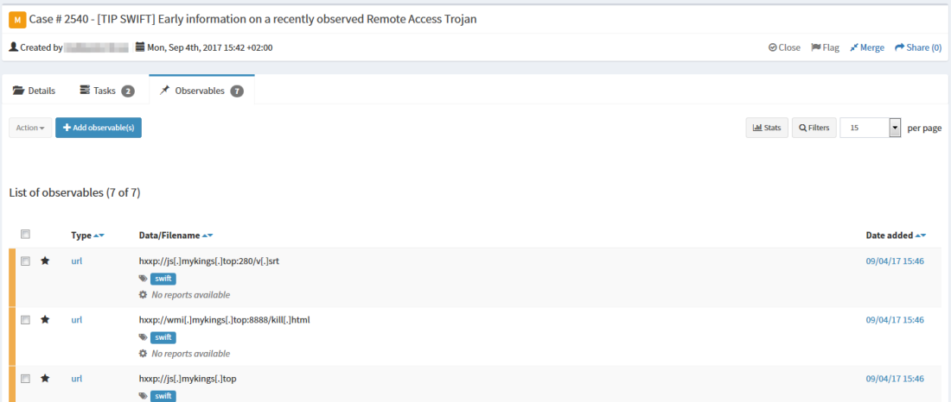
Misp export
Notes:
https://blogthehiveproject.files.wordpress.com/2017/09/export_case_1.png?w=1100

Slide 31
misp
Malware Information Sharing Platform
Widely Used
Easy to Automate
Integration with the Hive
Easily supports wide communities
http://www.misp-project.org/

Slide 32
MISP Stats
Started in mid March of 2018
~400 Events
Majority are Phishing
All data has been confirmed and analyzed before sharing

Slide 33
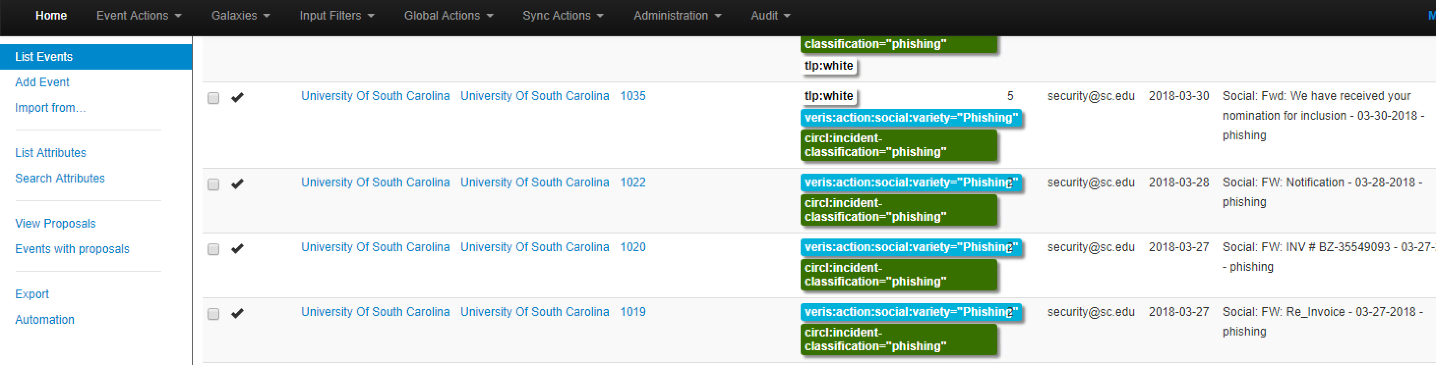
Event List

Slide 34
MISP Sharing
TLP (Traffic Light Protocol)
Red-Do not share
Amber-Only for your org
Green-Share to community but not public
White-Open to all, public
Distribution
You Org only
This Community (You are the spoke and no friend sharing
Connected Communities (Friend of Friends)
All (everyone)
Sharing Group

Slide 35
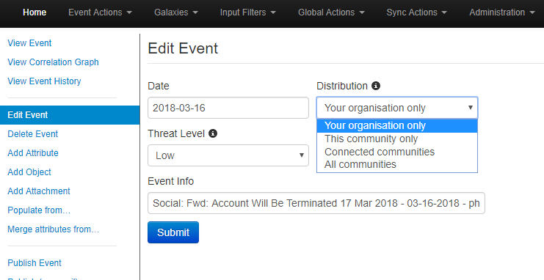

Slide 36
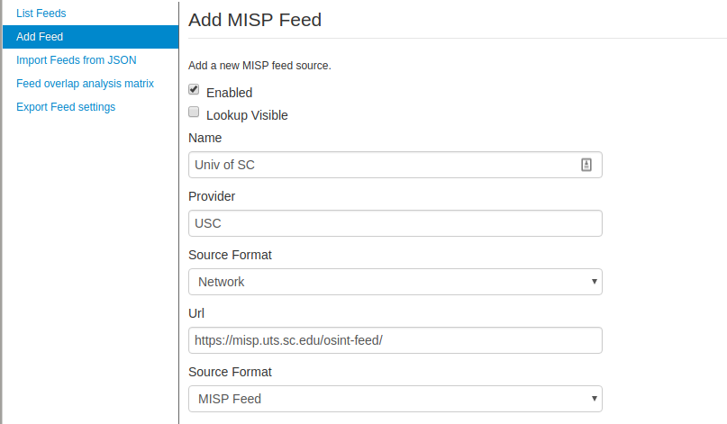
Subscribe to Our Public Feed
Notes:
https://misp.uts.sc.edu/osint-feed/

Slide 37
Already have MISP?
Send a request to peer at security@sc.edu
Almost ready to start doing this, but get in the queue
This will give you access to our non-public data tagged TLP:Green for our malware analysis.

Slide 38
Hive SeaRch MISP for IOC
You can setup the Hive to search you MISP instance for IOCs stored in MISP.
This will be you feed from other organizations and OSINT to better give you of an idea who else is seeing this.

Slide 39
Now we have IOC, How are we using them?

Slide 40
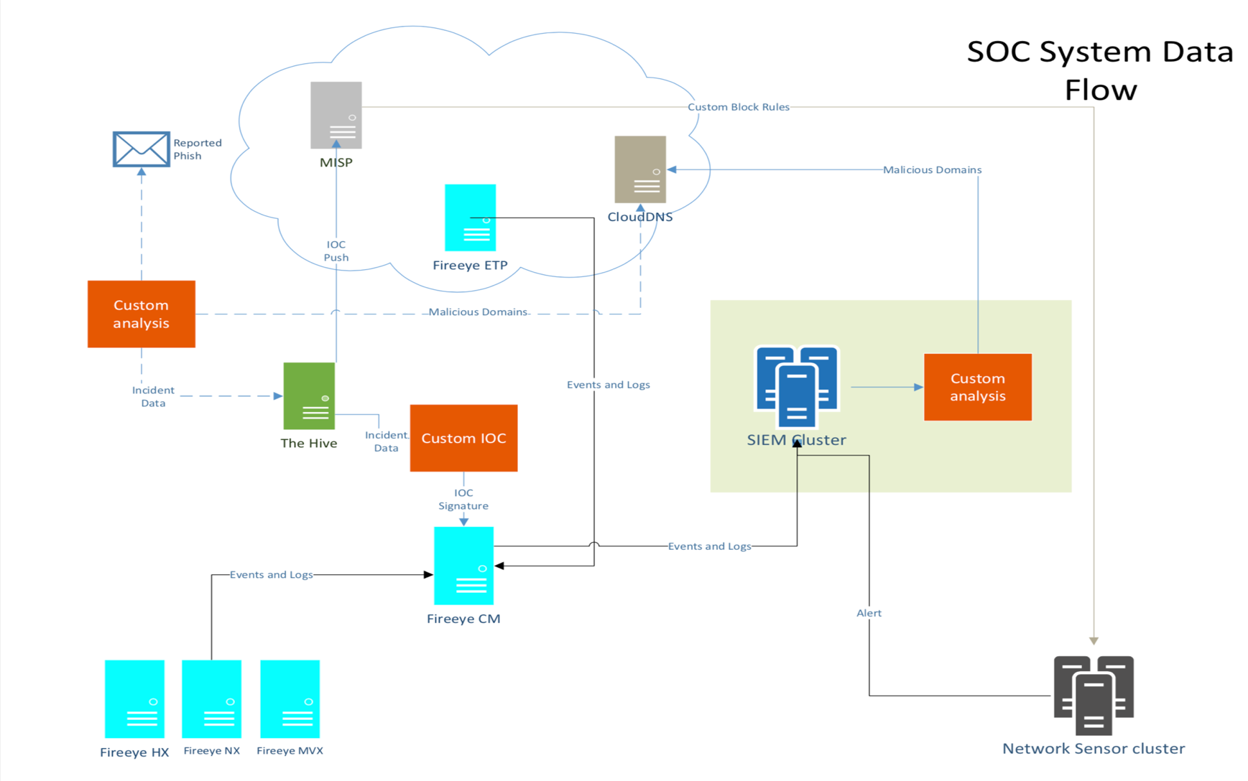

Slide 41
How has this Helped?
Forced change to improve documentation of IOCs due to workflow
Saved Time
Cortex gathering data
Investigation has already been completed with same malware
More consistent IR process
What to do is built into the process

Slide 42
Cisco Umbrella Feed

Slide 43
OSSEC
API pulls malicious filenames and paths
Creates Rootkit rules

Slide 44
Custom Bro Rules
Script that pulls IPs and Domain names
Intel.dat file

Slide 45
Future
Better utilizing data in MISP
MISP Workbench for correlation for attackers
Adding more data
Possibly having an internal only MISP server
Start adding MITER ATT&CK framework Galaxies
More automation to improve response time
Auto collect network pcap around time of incidents
Custom IOC in Fireeye
Automated Firewall block

Slide 46
Questions?

